Slide 1
TK2100: Informasjonssikkerhet Lesson 05: Network 1
Dr. Andrea Arcuri
Westerdals Oslo ACT
University of Luxembourg

Slide 2
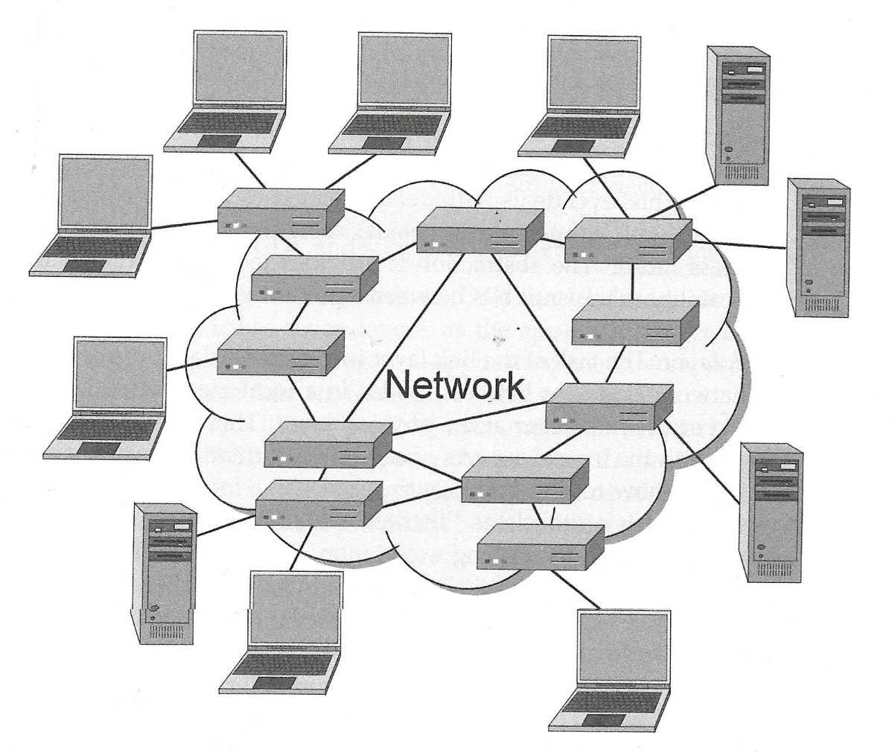
Goals
Understand how computers can communicate over a network
eg, using browser to visit web pages
Understand how an attacker can comprise communications over a network

Slide 3
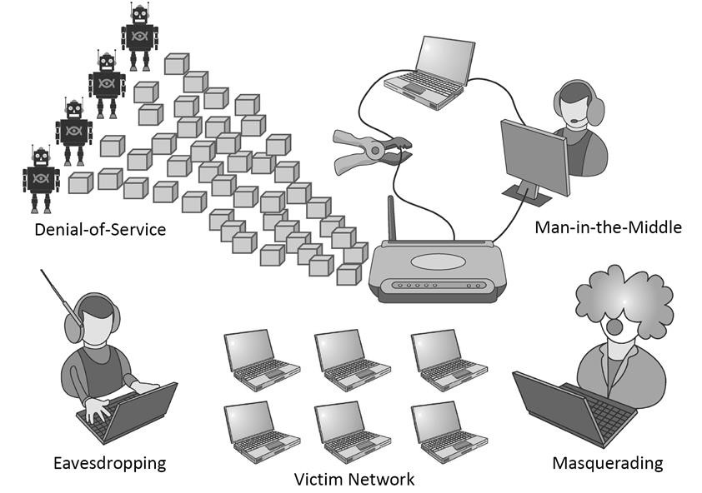

Many Different Kinds of Attacks

Slide 4
Internet Protocol Layers
Communications over internet are very complex
The sending/receiving of messages is abstracted in layers
When programming at a certain level, do not need to know of the layers directly underneath
eg, when making a request to retrieve an HTML page using HTTP, do not need to have to deal with low level details of sending of packets over a fiber optic vs WiFi
Not only this makes coding easier, but also enable the use of variegated protocols/hardware in the lower layers

Slide 5
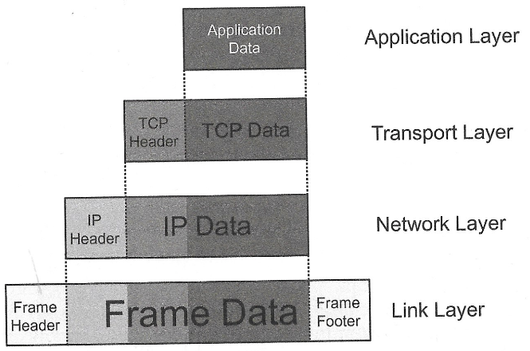
5 Main Layers
Physical Layer is the one in which the 0/1 bits of the data are sent
0/1 are sent in groups, ie in packets
A packet contains a header and a payload (sometimes also a footer)
The payload in one level is the entire packet (header+payload) of its above layer

Slide 6
Overview: Physical Layer
Dealing with the low level details of the actual sending of 0/1 bits between two nodes
Handling of connections on copper wires, coaxial cables, optical fiber cables or wireless radio
Best Effort: cannot guarantee that bits arrive

Slide 7
Overview: Link Layer
Dealing with communications between 2 nodes on same local area network (LAN)
eg, different machines connected to same WiFi router/switch
Need to find good paths connecting the 2 nodes
Protocols like Ethernet
MAC addresses to identify nodes on the local network

Slide 8
Overview: Network Layer
Moving of packets between nodes on wide area networks, like internet
Nodes identified with IP addresses, eg 127.0.0.1
IP (Internet Protocol)
Best Effort: cannot guarantee a packet is going be delivered without problems

Slide 9
Overview: Transport Layer
Establish connection between different processes/applications on different nodes
An application address is identified with an IP address AND a port number
Protocols like TCP and UDP
Can guarantee delivery (or tells you when that does not happen) of packets (eg, by automatically resending the lost ones)

Slide 10
Overview: Application Layer
Specific protocols for specific kinds of applications
Eg, HTTP for web pages, and SMTP for emails
By using a standard protocol, when you deploy your web applications to a conforming web server, then you know that all major browsers will be able to interact with them

Slide 11


























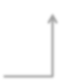
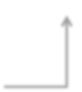

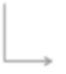










Application
Application
Transport
Transport
Network
Network
Network
Network
Link
Link
Link
Link
Ethernet
Fiber Optic
Wi-Fi
Physical Layer

Slide 12
Network Security Issues: CIA
Confidentiality: no requirement in any of the layers. If you need confidentiality, you need protocols that support encryption, like HTTPS and IPsec
Integrity: support for basic checksums. Can detect small changes, but not cryptographically secure
Availability: internet is designed to tolerate failure of routers and hosts, but cannot make strong guarantees, especially in the case of DDoS

Slide 13
Checksum
Technique to check if data has been altered
This could happen due to errors at physical layer, or if hacker altering messages
Simple checksum: add one extra bit, checking if in the data the number of 1s is even or odd
Receiver of message will check if checksum is correct or not
In this latter case, message has been altered

Slide 14
Checksum Example
A simple checksum (0 if even number of 1s, 1 otherwise) will only detect differences of 1 single bit change
Tradeoff: message is now 1 bit longer
Receiver: 1 wrong bit, can detect, as checksum would had been 1 if correct, and not 0
Transmission errors
0 | 1 | 1 | 0 | 0 | 1
Sender: checksum 0
0 | 1 | 1 | 0 | 1 | 1
Receiver: cannot detect 2 changes
0 | 1 | 1 | 1 | 0 | 1

Slide 15
Network Security Issues: AAA
Assurance: usually packets are allowed to be sent between 2 nodes. Preventing it has to be done explicitly, eg a firewall in a local network
Authenticity: on internet protocol, no concept of users, as communications are between computers, not people. If needed authenticity, have to handle it at application layer
Anonymity: built-in anonymity, as no concept of users. Agencies tracking users need to correlate with other source of info, like credit cards and mobile subscriptions

Slide 16
Link Layer

Slide 17
Ethernet
A Link Layer protocol, standardized as IEEE 802.3
Communications on cables
Physical transmission: frames (ie messages) sent as electrical impulses
If collisions (two machine sending impulses at same time), they will resend after a random amount of time

Slide 18
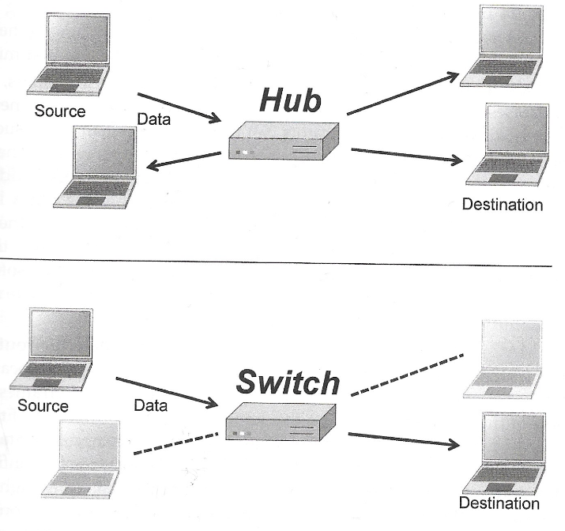
Hubs and Switches
Hardware components
Hub: does broadcast of all incoming electrical impulses, ie the frame packets
Switch: start with broadcast, but, once learned the MAC addresses, only send frames to the right route
Nowadays, Switches are used and not so many Hubs, as more efficient and not so expensive anymore

Slide 19
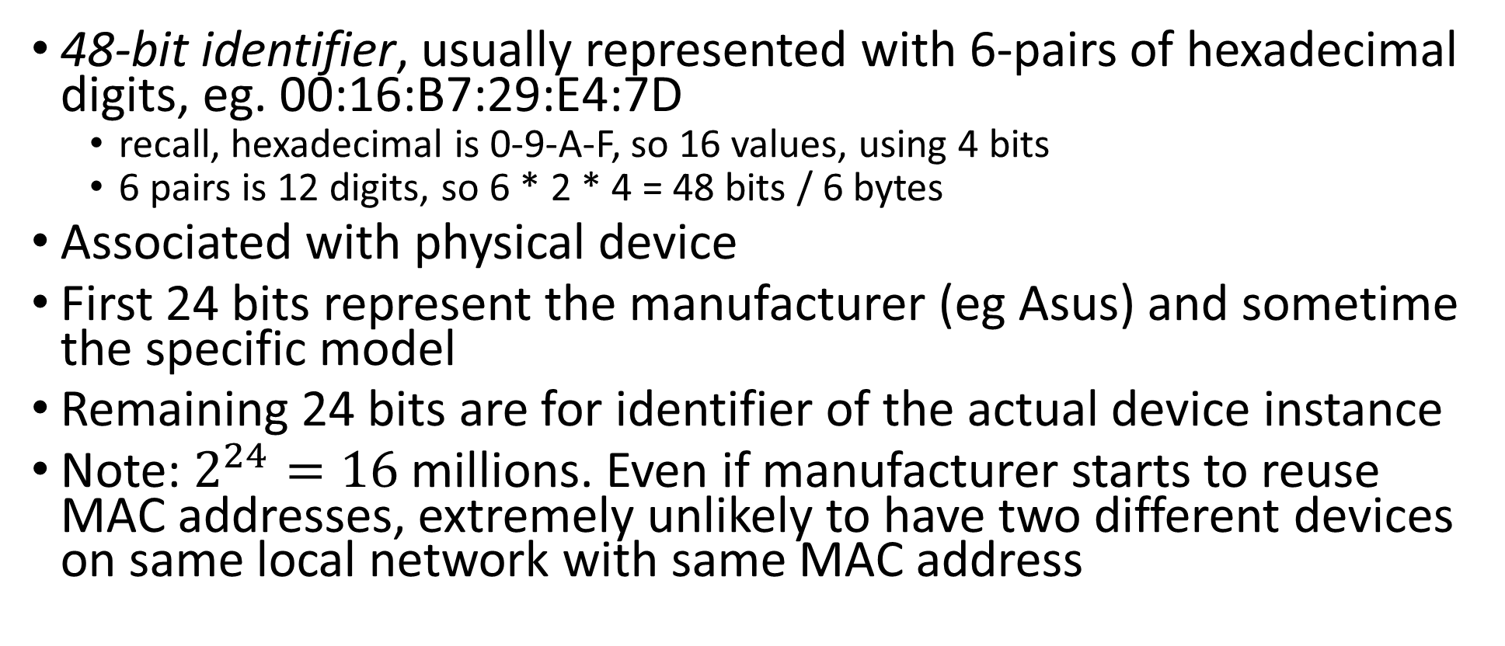
Media Access Control (MAC) Addresses
48-bit identifier, usually represented with 6-pairs of hexadecimal digits, eg. 00:16:B7:29:E4:7D
recall, hexadecimal is 0-9-A-F, so 16 values, using 4 bits
6 pairs is 12 digits, so 6 * 2 * 4 = 48 bits / 6 bytes
Associated with physical device
First 24 bits represent the manufacturer (eg Asus) and sometime the specific model
Remaining 24 bits are for identifier of the actual device instance
Note: $2^{24}=16$ millions. Even if manufacturer starts to reuse MAC addresses, extremely unlikely to have two different devices on same local network with same MAC address

Slide 20
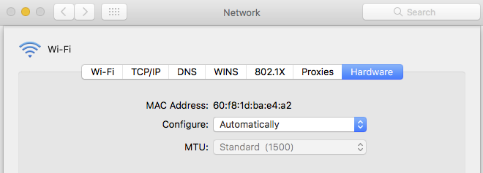
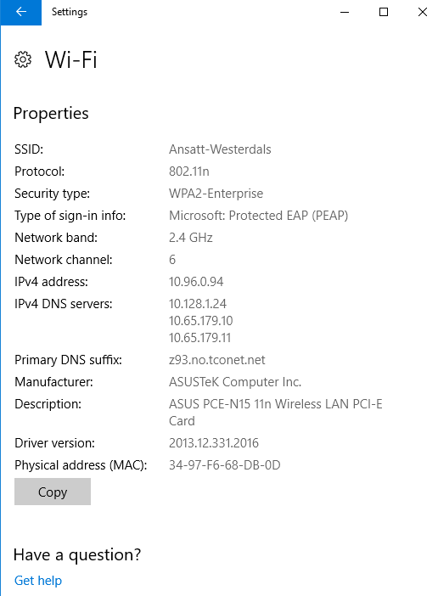
Windows
Mac

Slide 21
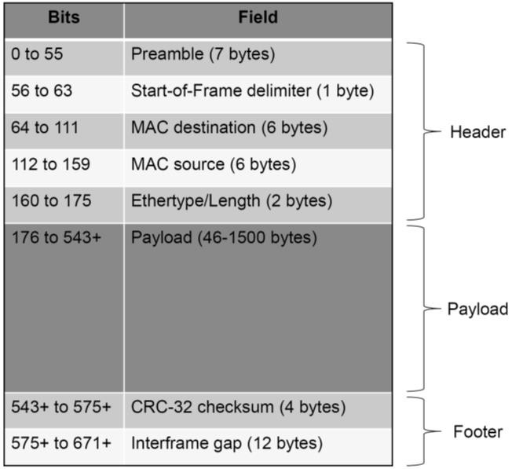
Ethernet Frame Format
Header: eg, source and destination MAC addresses
Payload: the actual data, which usually would be a Network Layer packet
Footer: eg, a checksum

Slide 22
Address Resolution Protocol (ARP)
The Link Layer works with MAC addresses
But messages in the higher layers work with IP addresses
ARP is a protocol to resolve an actual MAC address from the specified IP address

Slide 23
ARP Broadcast
Assume ARP is used to resolve the MAC address for the IP 192.168.1.105
ARP will send a broadcast on the LAN looking like: “Who has the IP address 192.168.1.105?”
All machines on the LAN receives the broadcast, and the one with that IP address will respond
ARP Cache: the mapping can be cached. So once a node finds out who has that IP, does not need to re-ask again

Slide 24
ARP Spoofing
Any machine could reply to the ARP broadcast
A malicious machine could lie and tell it is the one representing the requested IP address
Man-in-the-Middle attack: trick Alice and Bob to send their messages to Eve

Slide 25


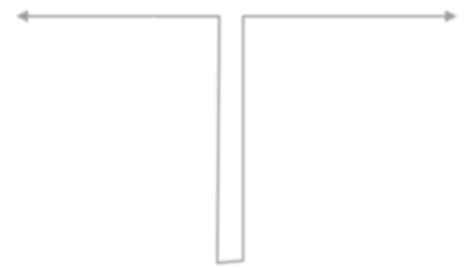
MAC: 00:0A:E4:2E:9B:11
Client
LAN: 192.168.1.0/24
MAC: 00:0A:E4:3B:47:7E
Server
Alice
IP: 192.168.1.10
ARP Poisoning
Bob
IP: 192.168.1.42
192.168.1.42 is
00:22:64:34:60:88
192.168.1.10 is
00:22:64:34:60:88
ARP response
Bob’s IP→ Eve’s MAC
ARP Response
Alice’s IP→ Eve’s MAC
Eve
MAC: 00:22:64:34:60:88

Slide 26
ARP Spoofing Prevention
Different prevention mechanisms
Simplest: check if more than one different machine answer to a ARP request
cannot know which is the true one, but at least can know if someone is messing up with the network
Static ARP tables: manual registration of MAC addresses to static, fixed IP addresses on a local network

Slide 27
Network Layer

Slide 28
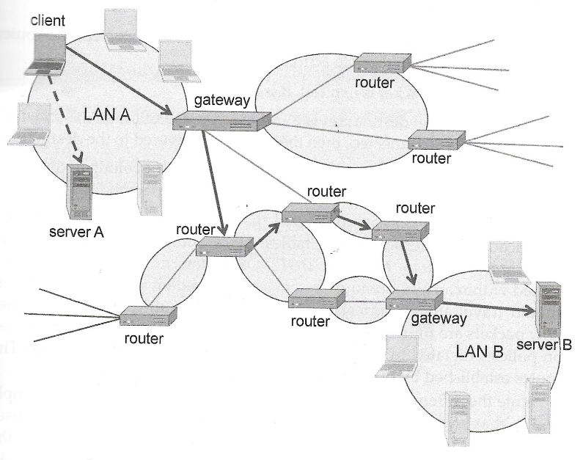
Internet Protocol (IP)
A network protocol to move packets between 2 nodes on the internet
Internet can be seen as a collection of independent LANs connected via routers and gateways
Link Layer works on a LAN, but here we need communications with nodes on different LANs

Slide 29
IP Addresses
2 main versions, IPv4 and IPv6
IPv4: 32-bits, currently most used, but running out of available new addresses for new machines
Represented with by 4 byte numbers (0-255 values) separated by “.”, eg 127.0.0.1
IPv6: 128-bits, slowly trying to replace IPv4…

Slide 30
Routing IP Packets
If destination IP address is on same LAN, use ARP to get MAC address, and send it directly via Link Layer
If destination IP address is on different LAN, need to send packet to the LAN Gateway
Client needs to know IP address of Gateway, and then use ARP to get its MAC to send packet to it
When Gateway receives packet for node not in the LAN, needs to route it out toward other routers

Slide 31
Gateways
Each LAN has 1 gateway (e.g., a WiFi router), which is the entry/exit point for the LAN
A packet might go through several routers before reaching the gateway of the destination LAN
Very complex algorithms to find out to which router to send packet next

Slide 32
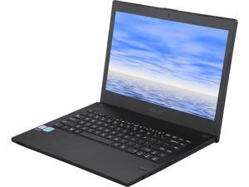
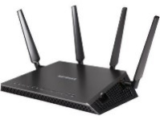
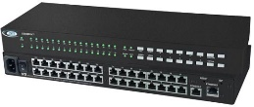
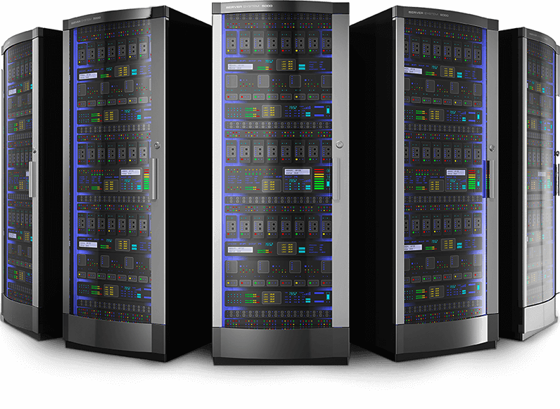
Paths
Sender
Many paths from a sender to a receiver
Ideally, want the shortest one
Problems: (1) routers can come and go; (2) a single router does not know the whole network topology; (3) some routers could be misconfigured
Note: finding shortest path in a graph is something that some of you will see in Algorithms course next semester
Receiver

Slide 33
Sender
Sender
Receiver
Receiver

Slide 34
Cycles
Sender
Due to misconfigurations, or dynamic changes in topology, a packet could be sent back-and-forward in a cycle
Packet will never be delivered, and client will just wait for nothing, in eternity
Internet protocol has a mechanism to avoid such issue
Receiver

Slide 35
Time-To-Live (TTL)
Each IP packet has a TTL counter, eg set to N=50
Each time a router receives a packet, it decreases the counter by 1
When a router sees a TTL=1, it discards the packet, and send an error message back to the client sender
At most a path would be N long, and so impossible to have infinite cycles

Slide 36
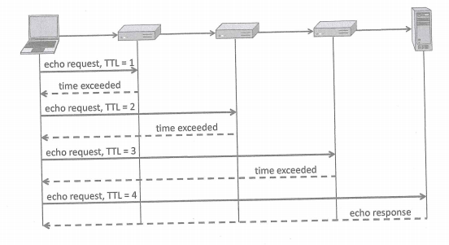
But what if low TTL on purpose?
Start sending IP packets with TTL=1, and increase by 1 at each new request
Each time getting back an error message from a router in the path
This way can find all routers toward destination

Slide 37
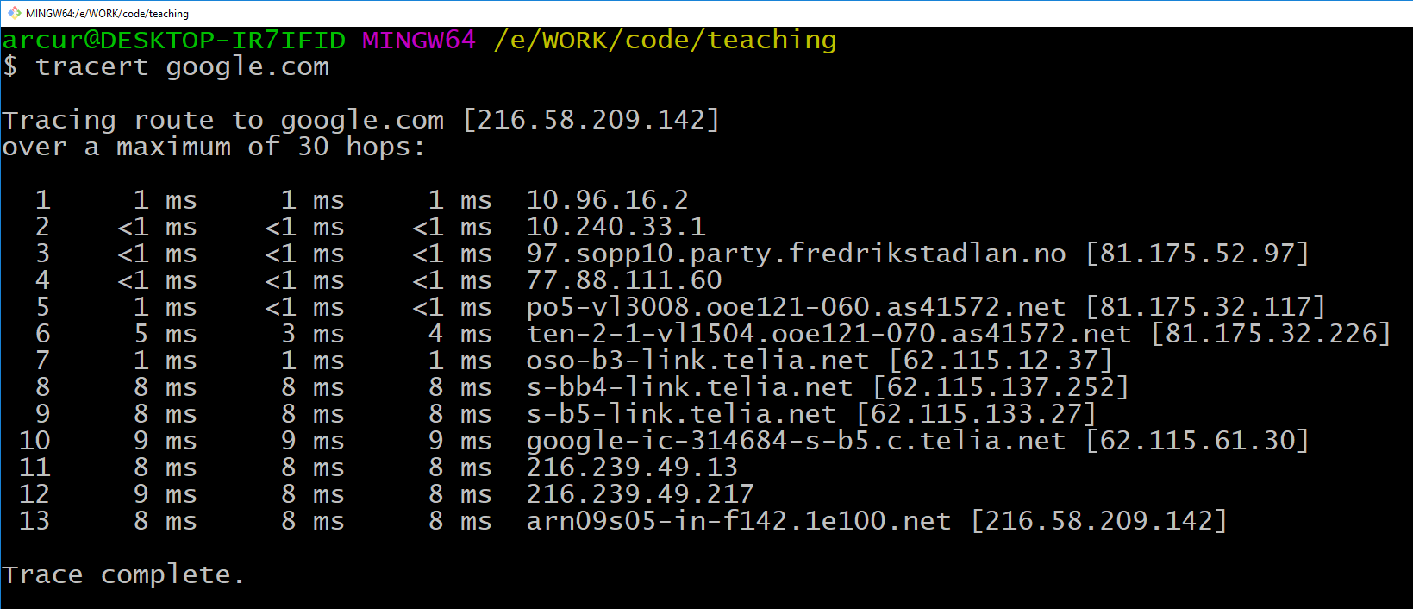
13 machines from Fjerdingen to google.com

Slide 38
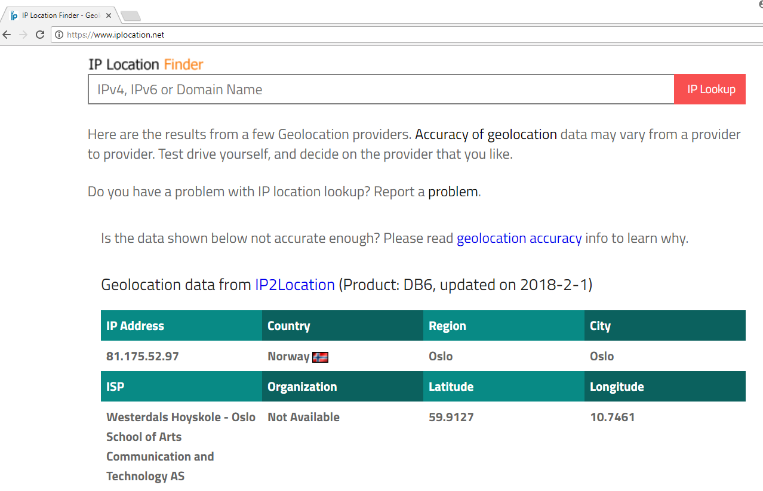
IP Registration
IP addresses are allocated/sold to companies by a standard internet organization
Given an IP address, can find owner and estimation of the location
Different services can tell you that, eg www.iplocation.net

Slide 39
On the route to google.com
10.x.x.x: local IP (discussed later)
81.175.52.97: Westerdals, Oslo
77.88.111.60: backbone router
62.115.137.252: Telia Company AB, Germany
216.58.209.142: Google, California
In other words, before reaching server in California, packets go first through Germany…

Slide 40
Internet Control Message Protocol (ICMP)
Protocol used to diagnostic a network
Ping: utility/program that checks if a host is reachable, and how long it takes to reach it
Traceroute: utility/program that checks the path toward a host
ie, what seen in previous slides based on TTL counters

Slide 41
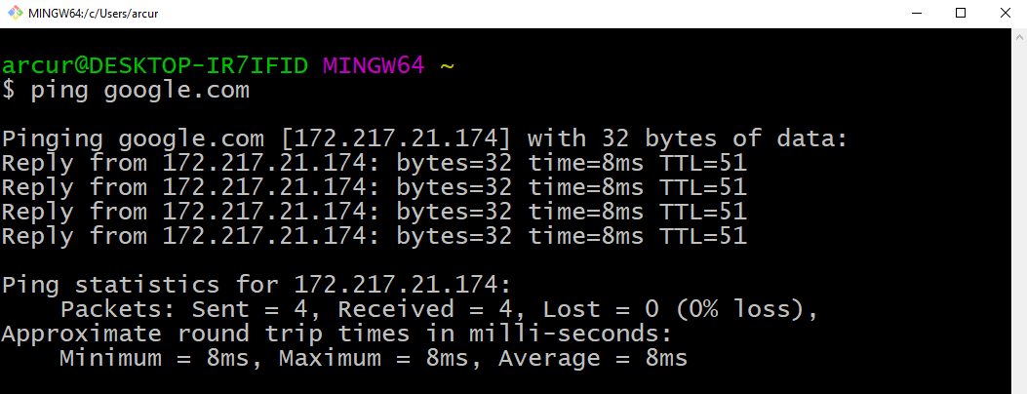
Pinging google.com: 8 milliseconds

Slide 42
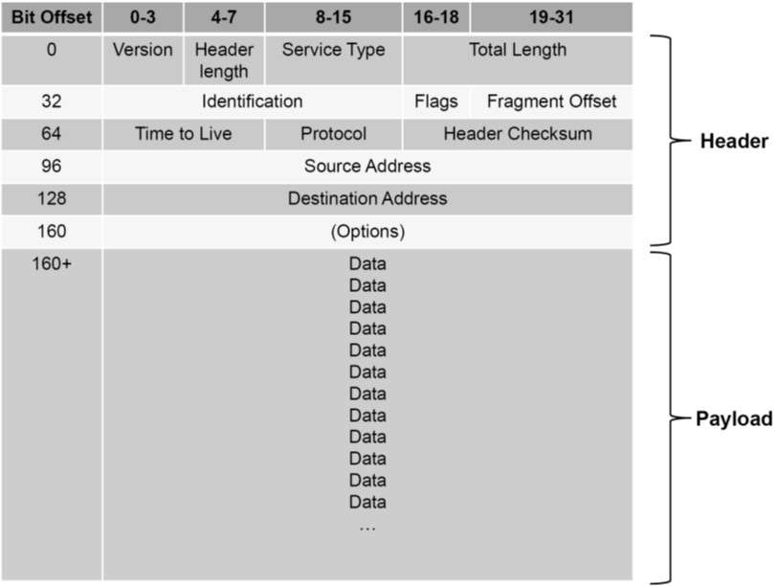
IP Spoofing
IP Packet contains “Destination” and “Source” addresses
But when you send a packet, you can alter the Source by using the IP of another machine
there is no check that Source address is the real one
You will not get the reply, the other machine specified in Source will get it
Why? Trick machine to send messages to another one (eg, DoS), or to circumvent firewall policies based on IP sources…

Slide 43
Packet Sniffing
When using hub, packets are broadcasted to all connected device
In WiFi, it is the same kind of broadcasting
A computer will receive all messages, but then discard the ones meant for other MAC addresses
You can analyze all packets, even the ones meant for others
Note: some network hardware cards do not support it, and neither some OS by default (eg, not trivial to get it to work on Windows…)

Slide 44
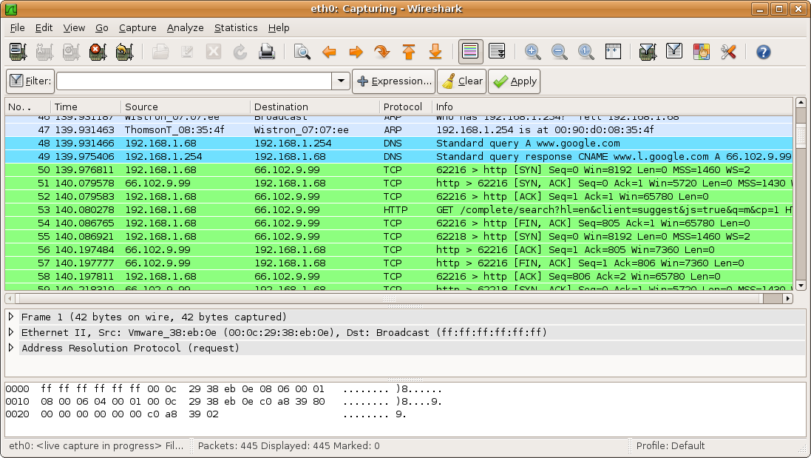
Wireshark

Slide 45
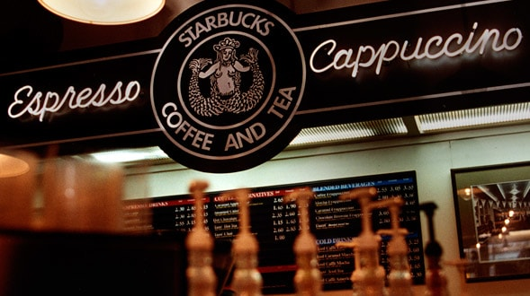
Please, do NOT…
… go to a place with a public WiFi…
… use Wireshark in promiscuous/monitor mode…
… and then check if any #@^%&* person is accessing not-encrypted web sites or mobile apps…
And first of all, do NOT be that kind of #@^%&* person!!!
Especially if you see someone running Wireshark on their screens…

Slide 46
Transport Layer

Slide 47
Applications
When application X wants to send a message to application Y on different machine S, needs to know its IP address
But on S there can be different applications running
How can we know on which application in S should the messages of X go to?
IP address of S is not enough… we also needs port numbers

Slide 48
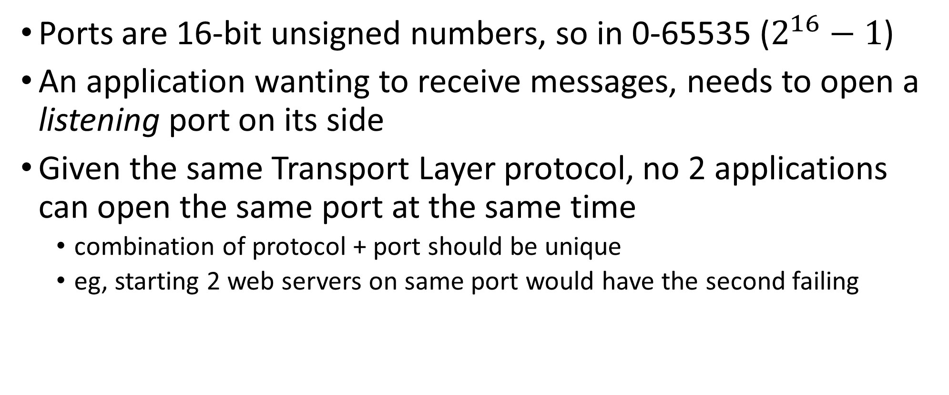
Ports
Ports are 16-bit unsigned numbers, so in 0-65535 ($2^{16}−1$)
An application wanting to receive messages, needs to open a listening port on its side
Given the same Transport Layer protocol, no 2 applications can open the same port at the same time
combination of protocol + port should be unique
eg, starting 2 web servers on same port would have the second failing

Slide 49
Ports to know
0: dynamically allocated (see next slide)
22: for SSH connections
Very common when you need to connect to a remote server or an IoT device using a terminal
80: for a HTTP connection
When browsing the web without encryption
443: for HTTPS, ie secure/encrypted HTTP over TLS/SSL
More and more common nowadays, even when no user authentication
8080: unreserved port.
“Typically” used by tools when running a HTTP server locally on your machine
Note: HTTP is an Application Layer protocol specific for the web

Slide 50
Ephemeral/Dynamic ports
“Typically” in range 49152–65535
But will vary based on the OS
For reading responses from the other machine
when you establish a connection to a remote machine, a port will be open locally to read the responses
During development, when using port 0
Get a dynamic port which is free, not used
Eg, if you want to start a server locally for debugging/testing, you might want to avoid conflicts with other applications using the same port

Slide 51
Defaults
When nothing specified, browsers do default to known ports for the given application protocol
Default protocol is HTTP, and default resource is the root “/”
So typing www.google.com is equivalent to http://www.google.com:80/
Typing https://www.google.com is equivalent to https://www.google.com:443/
Note: the page you request might not be the one you will get, as you could get a HTTP 3xx redirection

Slide 52

If you know the IP address, you can type it directly
Same “name” can be mapped to different IP addresses, ie different servers
The mapping can change
We will go in more details on DNS next class

Slide 53
Before going into the details…
… of Transport Layer protocols like TCP and UDP, let’s go back a moment to IP addresses
How many devices are connected to the internet?

Slide 54
Some Estimations
2016: around 300 Millions new devices connected each month
2020: estimated around 50 Billions devices connected
Why is this a problem?
IPv4 are 32-bits, so can only represent 4 Billion devices
What to do until IPv6 is widely supported?

Slide 55
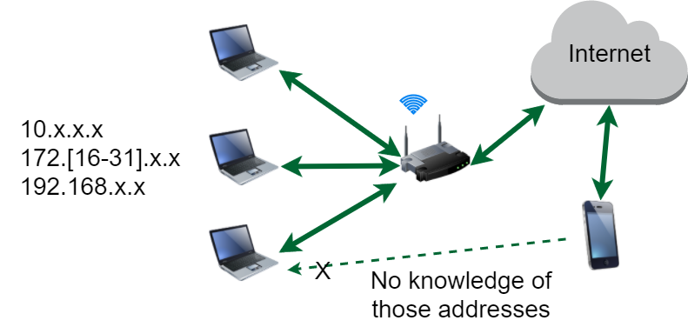
Local Networks
Router has IP accessible from internet
Machines connected to it have local IP not visible from outside
Cannot use mobile to connect to such machines, unless special settings on router, or WiFi directly to same router

Slide 56
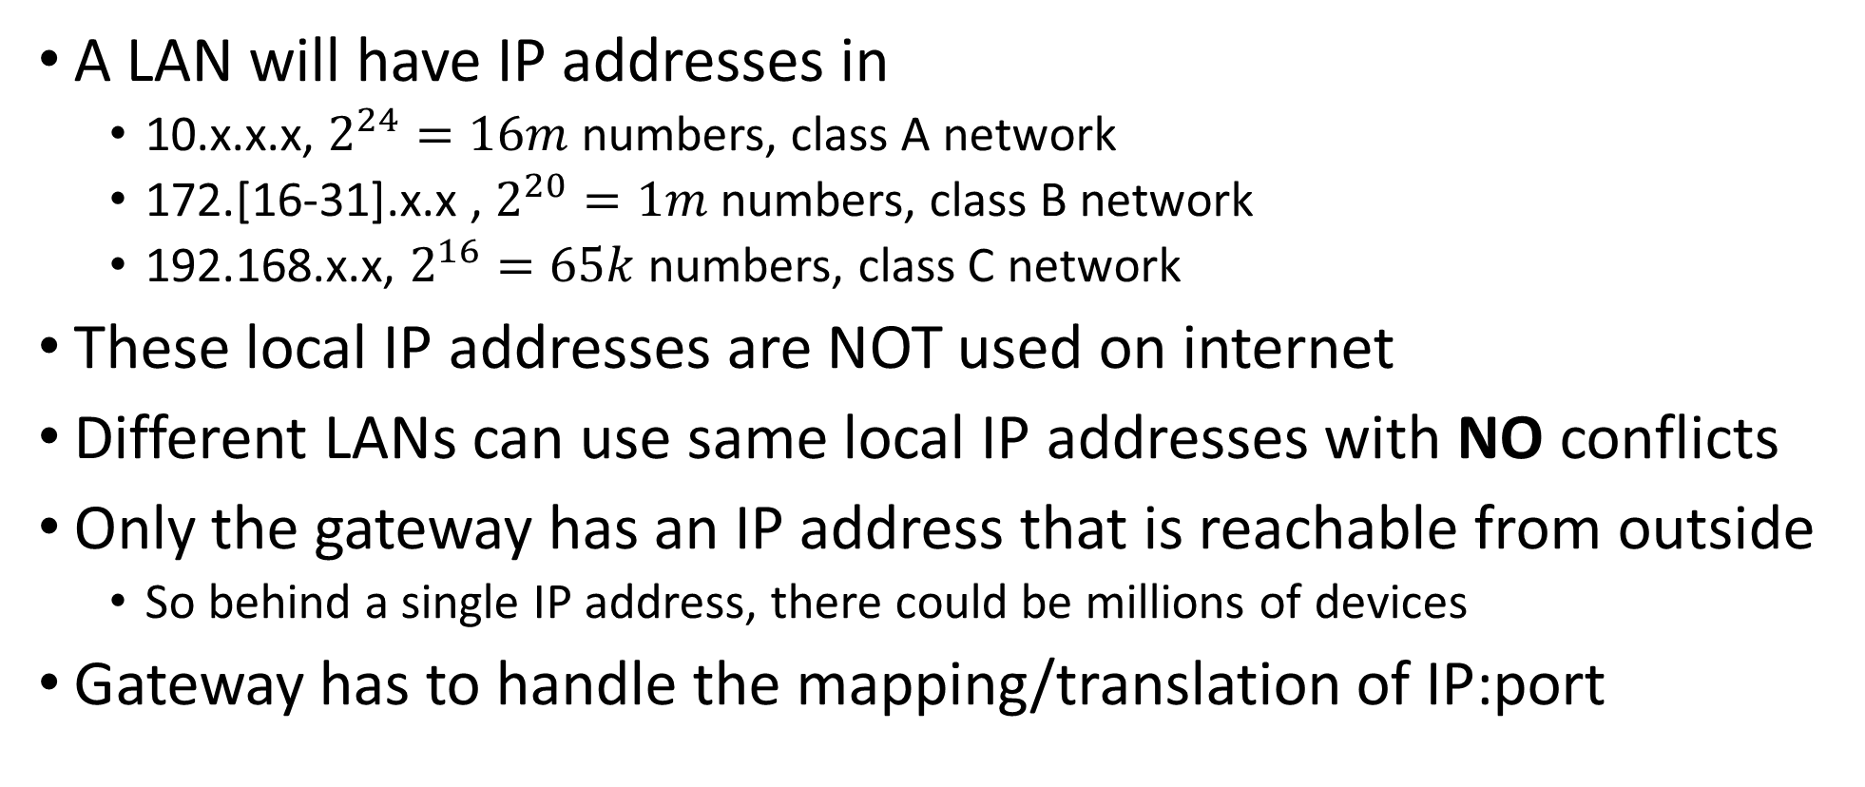
Network Address Translation (NAT)
A LAN will have IP addresses in
10.x.x.x, $2^{24}=16m$numbers, class A network
172.[16-31].x.x , $2^{20}=1m$ numbers, class B network
192.168.x.x, $2^{16}=65k$ numbers, class C network
These local IP addresses are NOT used on internet
Different LANs can use same local IP addresses with NO conflicts
Only the gateway has an IP address that is reachable from outside
So behind a single IP address, there could be millions of devices
Gateway has to handle the mapping/translation of IP:port

Slide 57
NAT Example
Let’s see a HTTP connection to google.com:80
Packet: source 192.168.0.1:61234, where the port is ephemeral
Gateway does change the packet content by replacing source with itself, with an ephemeral port that can be different (eg 12345)
Google will send back HTML page to the gateway at 81.175.52.97:12345
When gateway receives message on port 12345, it knows that it has to route it to 192.168.0.1:61234
Google server does NOT know about the IP and port of the laptop in the LAN
192.168.0.1:61234
81.175.52.97:12345
216.58.209.142:80

Slide 58
IP Addresses to Know
127.0.0.1
loopback address. Virtual one bypassing the network card. Useful for debugging, when running network applications (eg a web server) on your machine
10.x.x.x, 172.[16-31].x.x, 192.168.x.x
local LAN addresses
255.255.255.255
broadcast address. LANs might have it disabled for security reasons (discussed later)
0.0.0.0
all addresses on local machine. Useful when starting a server, and want it to listen to all possible incoming messages (a machine can have more than a network card, eg a cable and a WiFi)

Slide 59
How do you get an IP address in a LAN?
When you connect a laptop to a WiFi, you have an IP address
Connecting to a different network (eg, WiFi at home and at work) will likely result in having a different IP address
You can set up an IP address manually on your OS, but:
if this was not agreed with the network administrators, the network routers/switches might not route packages to it
if users choose own IPs, there can be clashes (eg 2 users trying to use same IP, and so network security system could think it is a man-in-the-middle attack)

Slide 60
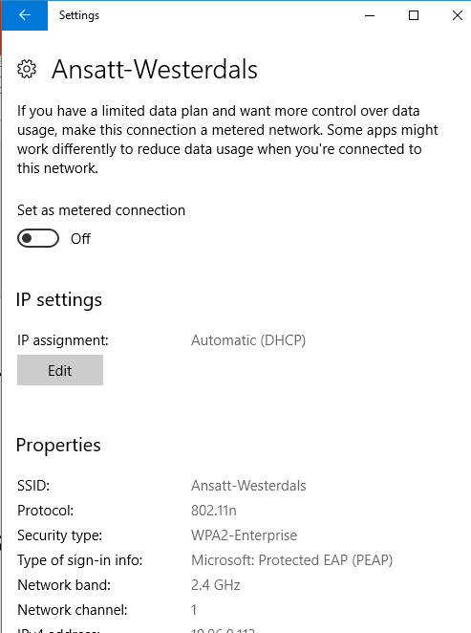
Dynamic Host Configuration Protocol (DHCP)
A LAN will have a DHCP server
A client computer connecting to the LAN will send a broadcast (eg 255.255.255.255) message stating to want an IP address, and providing its MAC identifier
it has to be a broadcast, because usually the client would not know a priori the IP address of the DHCP server
The DHCP will choose an available IP address, and send a broadcast message with the mapping IP-MAC
The client will then use such IP address
All other machines on network will ignore these broadcasts, as for different MAC addresses

Slide 61
UDP (User Datagram Protocol)
One of the main Transport Layer protocols
Single independent packets
No guarantee of delivery
No guarantee that packets are received in same order of sending
might go through different routing paths
Useful in time-sensitive applications when lost of some data is acceptable

Slide 62
TCP (Transmission Control Protocol)
The main protocol used for the web
eg, when using a browser to access HTML pages
Cannot guarantee delivery, but will try to resend packets if detects that were not received
ie, getting back an acknowledgement when packets are received
Packets are logically linked together in a session, each one having an increasing index number
Buffer of packets on receiving side, to re-order packets if arrived in wrong order
Can automatically slow down sending of packets if too many are lost

Slide 63











Three-Way Handshake
X and Y are originally chosen at random
Needed to decide increasing numbers for ordering of packets
If packet is received with an unexpected number, then buffered until the previous packets arrive
SYN
Seq = x
SYN-ACK
Seq = y Ack = x + 1
ACK
Seq = x + 1 Ack = y + 1

Slide 64
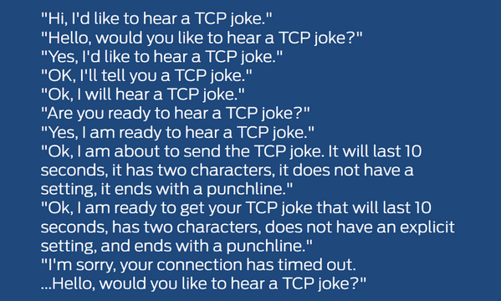

TCP vs. UDP

Slide 65
TCP Session Hijacking
Old TCP implementations used X-Y starting from fixed value, eg 0
Attacker can hijack a TCP connection, by sending packet with IP of attacked machine Z, and predict TCP session numbers
Note: the attacker will not see the responses (blind), because sent to Z, and that is the reason why it needs to find out the correct session numbers
Can do man-in-the-middle attack
Random session numbers prevent such issue
If on same LAN, can use Wireshark to see the session numbers
Have to use encryption to prevent this kind of attack

Slide 66
Example: after sending the first SYN by spoofing the IP of Alice, Eve needs to find out the Seq y=777 of Bob before sending the next TCP packet
Bob: 192.168.0.7
SYN
Seq x=123
Lying on IP source
Alice: 192.168.0.42
SYN-ACK:
Ack x=124
Seq y=777
Eve: 192.168.0.1
Alice: 192.168.0.42

Slide 67
Denial-of-Service (DoS) Attacks

Slide 68
Limits
Servers have limits on:
Memory
CPUs
Bandwidth
etc.
If receiving too many requests from an attacker, then server cannot answer legitimate users, ie a so called denial-of-service

Slide 69
Ping Flood Attack
Simple attack
Just do a lot of Ping/ICMP requests against a target
Only works if attacking machine has more resources than the victim one

Slide 70
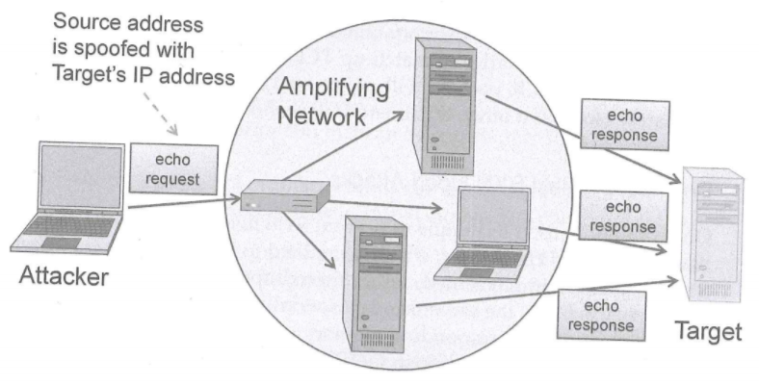
Smurf Attacks
Many LANs do have a broadcast address (e.g., 255.255.255.255)
A packet sent to such address will be broadcast to all machines on the network
If ICMP packet, the machines will reply to the source of that packet (eg Ping)
But you can spoof the IP of a target machine, and so use the whole network to DoS the target

Slide 71
WARNING!!!
A Smurf Attack is quite simple to do…
and just to be on safe side, I will not show the actual code, but you could google it…
Do NOT do this kind of attack (or any attack), nor any broadcasting, on the WiFi network in school…
due to some services needing it, broadcasting is not disabled
WiFi connections of students are logged, and this kind of disruption of school services (eg abuse of broadcasting or DoS) can be ground for degree termination and expulsion
this is explicitly stated in the contract you signed…
If you want to try it, do it at home with a private router you own…

Slide 72
SYN Flood
One of the most typical types of DoS attack
In TCP connection, server needs to keep some state
eg, the X/Y session numbers
An attacker might send many SYN requests, never followed by the ACK
Each time, different IP source (can be spoofed)
Server can run out of memory, because would keep state of connection until timeout
Some attempts to prevent this type of attack (eg SYN Cookies), but nothing widely used/supported

Slide 73
Distributed DoS (DDoS)
A single machine is unlikely to have the same resources of an enterprise system (eg, Amazon, Google or Facebook)
But with Malwares, can have a bot-army that can do SYN Floods
Servers of large corporations can be taken down

Slide 74
DDoS Prevention
If see that there are many requests coming from same IP, such IP can be blocked
But that is usually futile, as IP addresses can be easily spoofed
Many different techniques proposed to detect if packets are coming from the same source without relying on IP addresses
But because they require changes on all routers on internet, only little is really used in practice…

Slide 75
For Next Week
Book pages: 221-263
Note: when I tell you to study some specific pages in the book, it would be good if you also read the other pages in the same chapter at least once
Exercises for Lesson 5 on GitHub repository

